Slide 1
LOOPING STATEMENTS

Slide 2
LOOPING STATEMENTS
We use loops to perform repeated actions
Eg: If you are designed a task of printing numbers from 1 to 100 It will be very hectic to do it manually, loops helps us automate such tasks
for - loops through a block of code a number of times
while - loops through a block of code while a specified condition is true
do/while - also loops through a block of code while a specified condition is true

Slide 3
Types of Loops in JavaScript
for loop – Loop a block of code number of times
for in loop – loops through the key of an object
for of loop – loops through the value of an object
while loop – loops a block based on specific condition
do-while loop –while loop variant which runs atleast once

Slide 4
The for loop
The initialExpression initializes and/or declares variables and executes only once.
The condition is evaluated.
If the condition is false, the for loop is terminated.
If the condition is true, the block of code inside of the for loop is executed.
The updateExpression updates the value of initialExpression when the condition is true.
The condition is evaluated again. This process continues until the condition is false.
The syntax of the for loop is:
for (initialExpression; condition; updateExpression) {
// for loop body
}
var n=5;
for (i=0;i<=n;i++){
console.log(i);
}

Slide 5
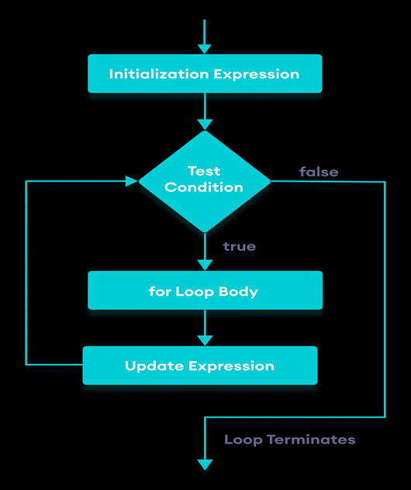

Slide 6
Tasks
Example 1: Display a text in 20 times
Example 2: Display Numbers from 1 to 5
Example 3: Display Sum of n Natural Numbers 1 to 100

Slide 7
The for in loop
Eg:
const student = {
name: 'Monica',
class: 7,
age: 12
}
// using for...in
for ( let key in student ) {
// display the properties
console.log(`${key} => ${student[key]}`);
}
Syntax:
for (key in object) {
// body of for...in
}

Slide 8
Task
Use for...in loop is used to iterate over the student object and print all its properties.
The object key is assigned to the variable key.
student[key] is used to access the value of key.
Input: Output:
const student={ name => Monica
name:’Monica’, class => 7
class:7, age => 12
age:12}

Slide 9
The for of loop
The syntax of the for...of loop is:
for (element of iterable) {
// body of for...of
}
iterable - an iterable object (array, set, strings, etc).
element - items in the iterable
// array
const students = ['John', 'Sara', 'Jack'];
// using for...of
for ( let element of students ) {
// display the values
console.log(element);
}

Slide 10
Comparison
for...of
for...in
The for...of loop is used to iterate through the values of an iterable.
The for...of loop cannot be used to iterate over an object.
The for...in loop is used to iterate through the keys of an object.
The for...in to iterate over an iterable such arrays and strings but you should avoid using The for...in for iterables.

Slide 11
The While loop
The syntax of the while loop is:
while (condition) {
// body of loop
}
A while loop evaluates the condition inside the parenthesis ().
If the condition evaluates to true, the code inside the while loop is executed.
The condition is evaluated again.
This process continues until the condition is false.
When the condition evaluates to false, the loop stops.

Slide 12
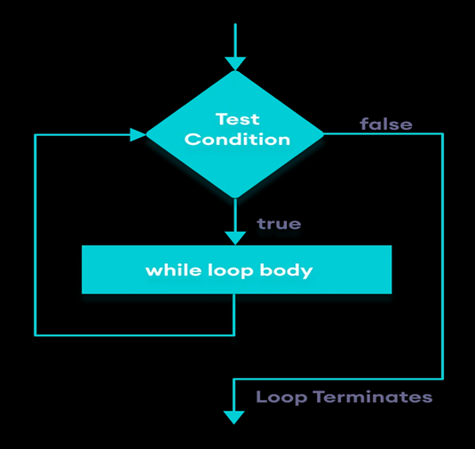

Slide 13
Tasks
Example 1: Display Numbers from 1 to 5
Example 2: Uses the while statement to output the odd numbers between 1 and 10.
Example 3:Find factorial of a number.

Slide 14
The do-while loop
The body of the loop is executed at first. Then the condition is evaluated.
If the condition evaluates to true, the body of the loop inside the do statement is executed again.
The condition is evaluated once again.
If the condition evaluates to true, the body of the loop inside the do statement is executed again.
This process continues until the condition evaluates to false. Then the loop stops.
The syntax of do...while loop is:
do {
// body of loop
} while(condition)

Slide 15
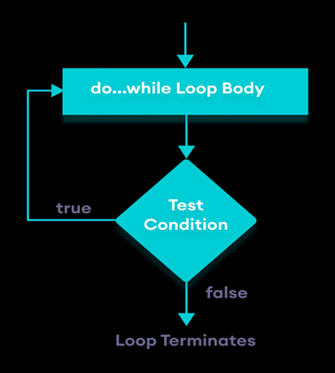

Slide 16
Tasks
Example 1: Display Numbers from 1 to 5
Example 2:Multiplication table for 5

Slide 17
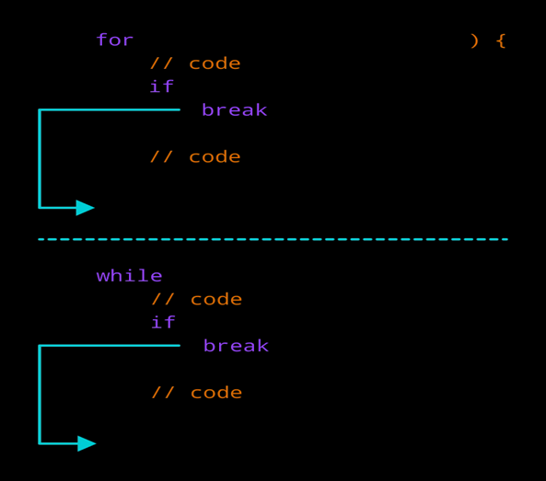
break Statement
The break statement is used to terminate the loop immediately when it is encountered.
The syntax of the break statement is:
break ;

Slide 18
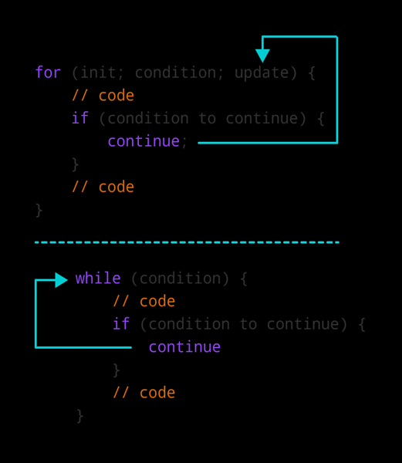
continue Statement
The continue statement is used to skip the current iteration of the loop and the control flow of the program goes to the next iteration.
The syntax of the continue statement is:
continue ;

Slide 19
Tasks
Task 1: write a program to print largest of three numbers
Task 2: Difference between while loop and do while loop.
Task 3: Difference between break and continue.
Task 4:Define an object with student names as properties and their marks as values
const students = { Amal: 78, Kiran: 98, Rahul: 87 };
Iterate through the object using a for...in loop and print the marks of each student

Slide 20
Thank you

